Slide 1
Object Oriented Analysis and Design
Component Diagrams

Slide 2
Deployment Diagrams
Deployment diagram is a structure diagram which shows architecture of the system as deployment (distribution) of software artifacts to deployment targets.
Denote the physical architecture of a computer-based system

Slide 3
Deployment Diagrams
Depicts a static view of the run-time configuration of hardware nodes and the software components

Slide 4
Artifacts
Artifacts represent elements in the physical world that are the result of a development process.
Examples of artifacts are executable files, libraries, archives, database schemas, configuration files, etc.

Slide 5

Node
A hardware or software object, shown by a three-dimensional box.
Connections between nodes are represented with a line

Slide 6
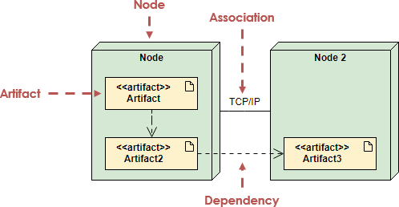

Slide 7
